Slide 1


Test Automation Using Selenium
Fair Hike Academy
That’s the way the cookie crumbles!
Session 1: Automation Testing Process
Mentor : Naresh Vulli, CSTE, PAHM.
fairhike@gmail.com www.fairhike.blogspot.com | www.facebook.com/fairhike

Slide 2
Today’s Topics
Automation Testing
Benefits of Automation
Problems
Guidelines
Automation Overall Process
Automation Tool Selection
Automation Development Process
Takeaway or Exercise

Slide 3
Automation Testing
Automation Testing is the use of software to control the execution of tests, the comparison of actual outcomes to predicted outcomes, the setting up of test preconditions, and other test control and test reporting functions – QAI CBOK

Slide 4
Benefits of Automation
Fast
Reliable
Repeatable
Reusable
Comprehensive
Programmable
Notes:
Fast : Automation tool runs tests significantly more faster than human users
Reliable : Automation tool can perform the same operation each time, if you repeat multiple times, so that we can eliminate human errors
Repeatable : We can check how application or website reacts after repeating the same operation multiple times
Reusable : Automation scripts are reusable on different version of the application of websites even if the user interfaces changes
Comprehensive : In automation testing we can build a suit of tests that covers every feature in the application or website
Programmable : We can program sophisticated Tests that bring out hidden information from the application

Slide 5
Problems
There are several problems that plague test automation projects :
Spare time test automation
Lack of clear goals
Lack of experience
High turnover
Reaction to desperation
Technology focus

Slide 6
Guidelines
Following Guidelines will help us in overcoming the problems with test automation projects:
Improve the Testing Process
Define Requirements
Prove the Concept
Champion Product Testability
Design for Sustainability
Plan for Deployment
Face the Challenges of Success

Slide 7
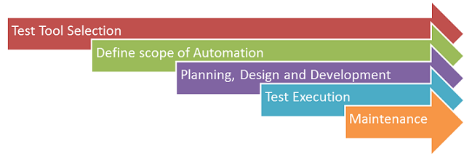
Automation Overall Process

Slide 8
Automation Tool Selection
Cost
Required Skill set
Supported Technologies
Maintenance Efforts
Trade-Off Features
Product Support

Slide 9
Automation Development Process
Planning
Design & Development
Execution
Automation Planning
Framework
Test Script
Development
Test Execution
Analyze Test cases for Automation
Feasibility Analysis
Define Folder Structure
Test Environment Set up
Test Data Set Ups
Page wise Classes & Methods
Dry Run – Test Scripts
Effort Estimation
Automation Test Plan
Define & Design Framework
Functional Classes
Execute Automation Suite
Prepare Traceability and Test Data
Test Data Mining
Sign-Off
Automation Suite
Review Test Case methods
Finalized Automation Scripts
Automation Suite Design
Automation Framework
Test Phase
Automation Team
Collaborative Team
QA Manager
Output / Deliverables
9

Slide 10
Takeaway or Exercise
Explore Different Automation Testing Process models
Explore Licensed and Open source Test automation tools

Slide 11
Q & A

Slide 12
Thank You ☺

